Slide 1
#02 Inheritance and Polymorphism
Notes:
Give an explanation for the concepts inheritance and polymorphism
Relevant theoretical decisions
What is inheritance, when and how is it used?
How are the relationship between references and objects in an inheritance hierarchy?
What are static and dynamic types?
What is polymorphism, when and how is it used?
How do you understand the concepts early and late binding?
What is a polymorphic method?

Slide 2
Inheritance
Interdependencies and Relationships
Generalization and Specialization
writing code that is reusable
new class, ListBox, which derives from Control
Notes:
C# has two separate mechanisms for writing code that is reusable across different types: inheritance and generics.
Inheritance is used for Generalization and Specialization of code.
Classes and their instances (objects) don’t exist in a vacuum, but rather in a network of interdependencies and relationships, just as we, as social animals, live in a world of relationships and categories.
The is-a relationship is one of specialization.
Saying that ListBox inherits from (or derives from) Control indicates that it specializes Control. Control is referred to as the base class, and ListBox is referred to as the derived class.
This code declares a new class, ListBox, which derives from Control. You can read the colon as “derives from.”

Slide 3
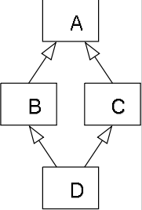
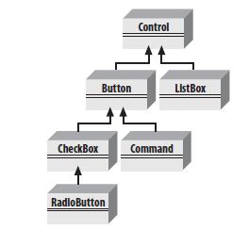
Hierarchy and Single Inheritance
C# does not allow multiple inheritance, but does allow implementing multiple interfaces
Semantic ambiguity
Notes:
In object-oriented programming languages with multiple inheritance and knowledge organization, the diamond problem is an ambiguity that arises when two classes B and C inherit from A, and class D inherits from both B and C. If a method in D calls a method defined in A (and does not override the method), and B and C have overridden that method differently, then from which class does it inherit: B, or C?

Slide 4
Static and Dynamic
Static
Compile-time type checking
Early type checking
Types are variables
Dynamic
Runtime type checking
Types are values
C# is a statically type language, but in C# 4.0 it is possible to bypass type checking
Notes:
Assigning data types (typing) gives meaning to collections of bits.
Static: A programming language is said to use static typing when type checking is performed during compile-time as opposed to run-time. In static typing, types are associated with variables not values. Static typing is a limited form of program verification (see type safety): accordingly, it allows many type errors to be caught early in the development cycle. Program execution may also be made more efficient (i.e. faster or taking reduced memory) by omitting runtime type checks and enabling other optimizations.
Dynamic: A programming language is said to be dynamically typed, when the majority of its type checking is performed at run-time as opposed to at compile-time. In dynamic typing, types are associated with values not variables. Compared to static typing, dynamic typing can be more flexible (e.g. by allowing programs to generate types and functionality based on run-time data), though at the expense of fewer a priori guarantees.

Slide 5
Polymorphism
Many forms
Notes:
There are two powerful aspects to inheritance. One is code reuse. When you create a ListBox class, you’re able to reuse some of the logic in the base (Control) class. What is arguably more powerful, however, is the second aspect of inheritance: polymorphism. Poly means “many” and morph means “form.” Thus, polymorphism refers to being able to use many forms of a type without regard to the details.
For example, a form might want to keep a collection of all the instances of Control it manages so that when the form is opened, it can tell each of its Controls to draw itself. For this operation, the form doesn’t want to know which elements are listboxes and which are buttons; it just wants to tick through its collection and tell each to “draw.” In short, the form wants to treat all its Control objects polymorphically.

Slide 6
Binding

Slide 7
Polymorphic method

Slide 8
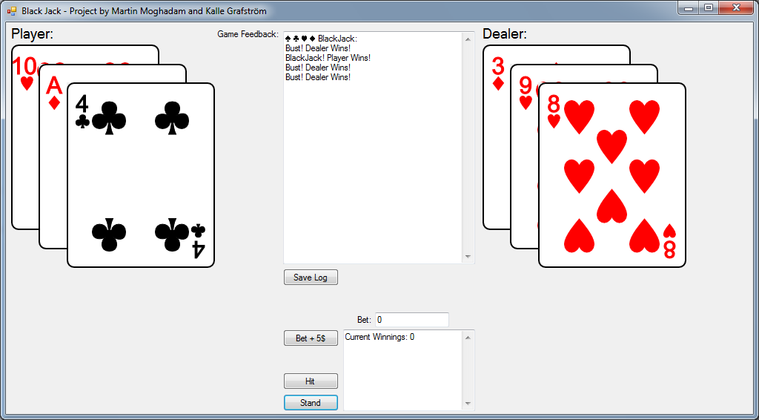
Our program
Black Jack Game
Log
Save Log
Beting
Hit
Stand

Slide 9
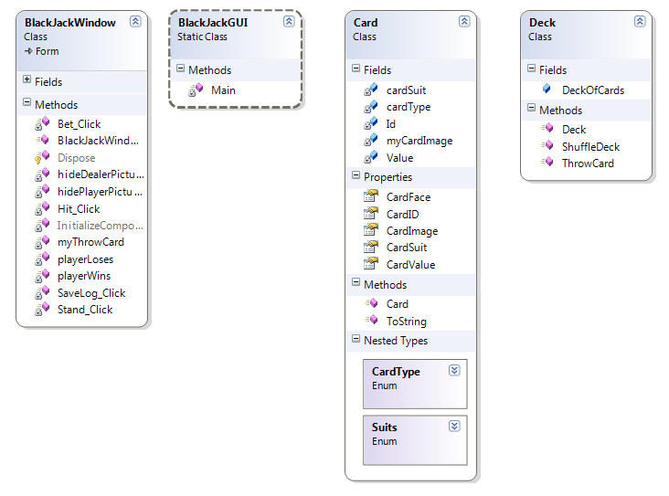
Our program
Notes:
Our application contains a simple card class, and a deck class.
A deck of cards is a list that contains objects of the type card.

Slide 10
Questions?

